Slide 2
SPARK 2014 – Formal Verification Made Easy
Yannick Moy
October 1st 2015
Notes:
SPARK 2014 is the new version of SPARK, a subset of Ada designed for formal verification.
The past two releases of the SPARK product were based on this new version, so many of you know a lot about what SPARK is.
Intro SPARK + contracts + plan (certif ou pas)
This presentation is not so much about what SPARK is, but about why and how to use it. And in particular, how it can be easily adopted in an your processes, and easily used by your teams.
Hence this bold claim: formal verification IS easy with SPARK 2014.

Slide 3
Easy to adopt, easy to use Multiple use cases Learning SPARK Technical roadmap

Slide 4

Crazyflie 2.0
1800 sloc stabilization in C
+ FreeRTOS
+ …
Notes:
Start with story that supports my bold claim.
This is the Crazyflie, a small leisure drone, originally programmed in C on top of FreeRTOS + libraries/drivers/etc all in C.

Slide 5

2 months later…
Crazyflie 2.0
1800 sloc stabilization in C
+ FreeRTOS
+ …
Crazyflie in Ada/SPARK
2100 sloc stabilization in SPARK
proved no run-time errors!
+ FreeRTOS
+ …
Notes:
This is our intern Anthony Leonardo Gracio.
Anthony had little knowledge of Ada and no knowledge of SPARK or of any static analysis tools prior to his internship.
Yet, in 2 months, Anthony rewrote completely the stabilization code of the Crazyflie in SPARK, and he proved absence of run-time errors on the SPARK code.
And the drone was flying better at this stage.

Slide 6
5 months later…
Crazyflie 2.0
1800 sloc stabilization in C
+ FreeRTOS
+ …
Crazyflie in Ada/SPARK
2100 sloc stabilization in SPARK
proved no run-time errors!
+ Ravenscar
will prove
no concurrency errors!
Notes:
Just give him 3 more months, and he rewrote the complete firmware in SPARK and Ada.
And now we expect to prove absence of concurrency errors with the upcoming version of SPARK that supports Ravenscar (safe tasking in Ada)
Anthony’s assessment of using SPARK was that it was intuitive! Not the typical feedback from people who use formal methods tools.
See demo

Slide 7
Easy to Adopt
Gradual adoption
SPARK is just Ada!
Some units in SPARK, others in Ada
Inside units, parts in SPARK and parts in Ada
Integrated in developer’s toolbox
Based on GNAT projects
SPARK tools integrated in GPS and Eclipse GNATbench
Notes:
Two features make SPARK easy to adopt in your processes:
SPARK is Ada!
SPARK is AdaCore technology!

Slide 8
Easy to Use
Incremental benefits
Usable without upfront work (no contracts)
Increasing benefits with more contracts
Highly interactive
Run at different levels of granularity (down to single line)
Run at different levels of power
Get precise results in GPS or GNATbench
Features to query results (paths, counterexamples)
Notes:
Two features of SPARK make it easy to use:
SPARK listens to you!
SPARK talks to you!

Slide 9
Multiple Use Cases (1/2)
Safe coding standard for critical (embedded) software
Increases portability across compilers/platforms
Prove absence of run-time errors (AoRTE)
In replacement of robustness testing
Equivalent to exhaustive testing
Few contracts required
Typically 95% - 98% of RTE proved
Proof can be completed by testing

Slide 10
Multiple Use Cases (1/2)
Safe coding standard for critical (embedded) software
Increases portability across compilers/platforms
Prove absence of run-time errors (AoRTE)
In replacement of robustness testing
Equivalent to exhaustive testing
Few contracts required
Typically 95% - 98% of RTE proved
Proof can be completed by testing

Slide 11
Multiple Use Cases (2/2)
Prove correct integration between components
In replacement of defensive coding
Simple contracts are needed
Prove functional correctness (including input partitioning)
In replacement of unit testing
More complex contracts are needed
Safe optimization of run-time checks

Slide 12
Combining Proof and Test
At the level of individual runtime checks
Possible RTE covered by tests
Also the approach in VectorCAST with CodePeer
Between proof and integration testing
Contract used for AoRTE at unit level
Same contract used for integration testing (no unit tests)
Between proof and unit testing
Contract as boundary between proof and unit test
Very relevant in DO-178C context for avionics

Slide 13
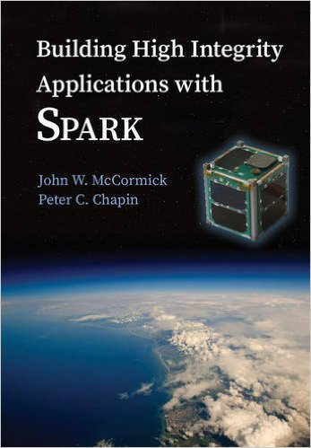
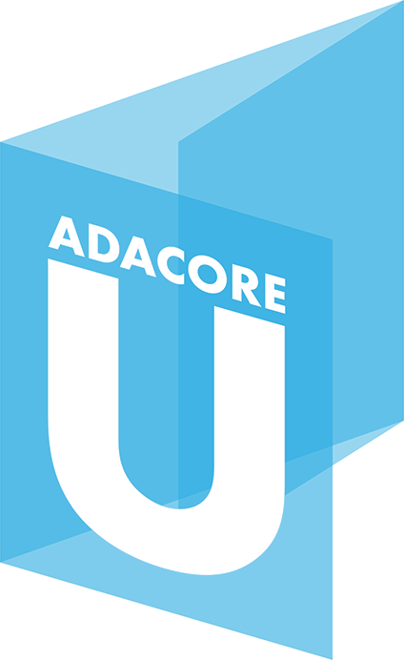
Learning SPARK: Contracts
Overview of SPARK Language (SPARK User’s Guide)
Subprogram contracts
Package contracts
Type contracts
Tagged Types and Liskov Substitution Principle
SPARK Book (McCormick & Chapin)
SPARK Courses
Tutorials, webinars, trainings
AdaCore University (u.adacore.com)

Slide 14
Learning SPARK: GNATprove
Formal Verification with GNATprove (SPARK User’s Guide)
Running the tool and viewing results, but also…
How to use GNATprove in a team
How to write subprogram contracts
How to investigate unproved checks
…
GNATprove by Example (SPARK User’s Guide)
SPARK Book and Courses

Slide 15
In The Next Release
New language features
Support for Ravenscar profile of tasking
Support for ghost code
Support for type predicates
Improved provability
New provers CVC4 and Z3 (in addition to Alt-Ergo)
Much better handling of bitwise and floats
Improved interaction
Generation of counterexamples when not proved

Slide 16
In The Next Release
New language features
Support for Ravenscar profile of tasking
Support for ghost code
Support for type predicates
Improved provability
New provers CVC4 and Z3 (in addition to Alt-Ergo)
Much better handling of bitwise and floats
Improved interaction
Generation of counterexamples when not proved

Slide 17
Support for Ghost Code
^{contracts}
ghost
functions
with assertions
+
^{code}
compile
^{executable}
used in formal + test

Slide 18
Support for Ghost Code
^{contracts}
ghost
functions
with assertions
+
ghost
variables,
types,
procedures
^{code}
compile
^{executable}
used in formal + test

Slide 19
Support for Ghost Code
^{contracts}
ghost
functions
with assertions
+
ghost
variables,
types,
procedures
^{code}
compile
^{executable}
removed in final build

Slide 20
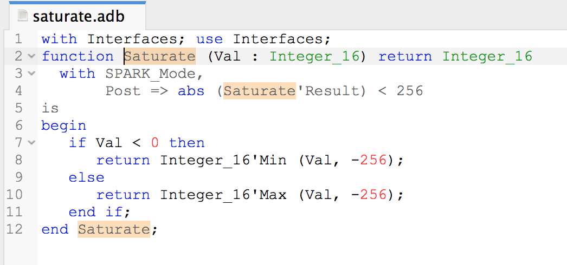
Generation of Counterexamples

Slide 21
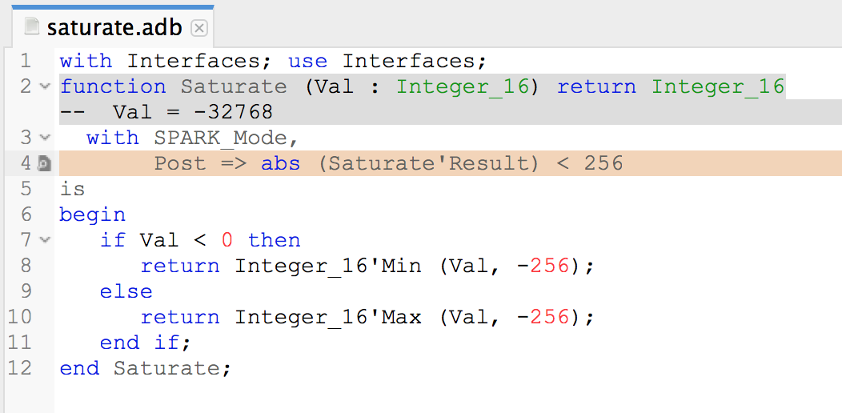
Generation of Counterexamples
saturate.adb:4:16: medium: overflow check might fail

Slide 22

Generation of Counterexamples
saturate.adb:4:16: medium: overflow check might fail

Slide 23
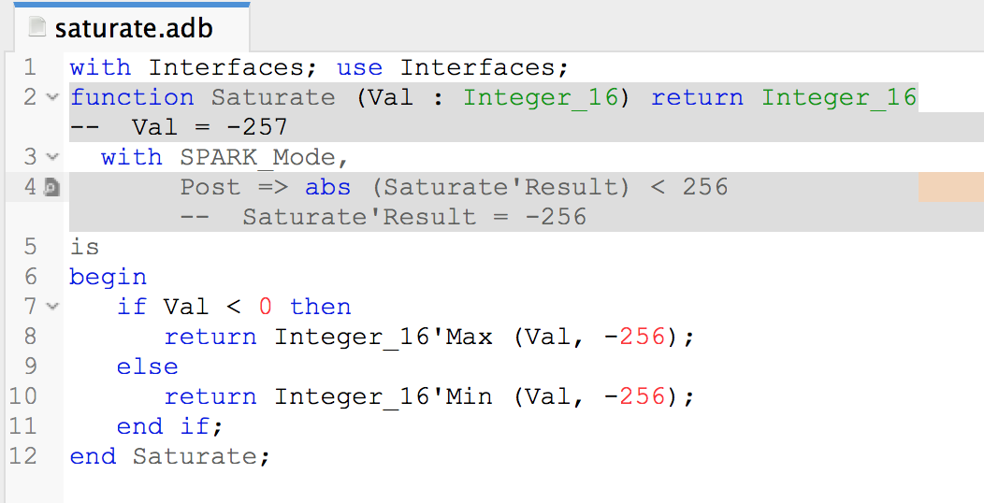
Generation of Counterexamples
saturate.adb:4:16: medium: postcondition might fail

Slide 24
Generation of Counterexamples
saturate.adb:4:16: medium: postcondition might fail
Notes:
See change for fix

Slide 25
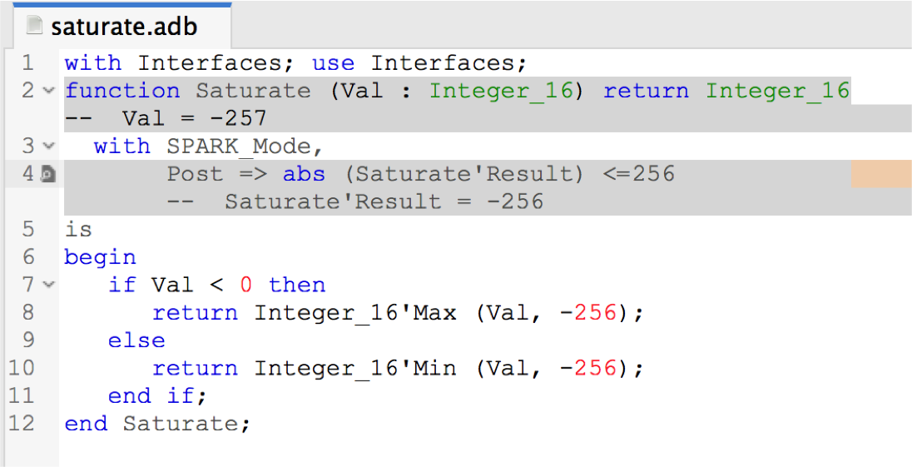
Generation of Counterexamples
saturate.adb:4:16: medium: postcondition might fail
Notes:
See change for fix

Slide 26
Beyond The Next Release
New language features
Support for type invariants
Support for simple pointers
Improved provability
Integration of CodePeer static analysis in GNATprove
Improved interaction
Better integration between SPARK and C
Metrics and indicators for formal developments
Notes:
Explain benefit of CodePeer

Slide 27
SPARK Is Good For You…
If you want to get guarantees about your software
At a reasonable cost
With your existing team / tools / processes
… We’re here to help!
Notes:
Summarize presentation content by restating the important points from the lessons.
What do you want the audience to remember when they leave your presentation?

Slide 28


Resources
SPARK Pro webpage
http://www.adacore.com/sparkpro
SPARK community page
http://www.spark-2014.org
SPARK User’s Guide
http://docs.adacore.com/spark2014-docs/html/ug
AdaCore University
http://u.adacore.com

